Slide 1
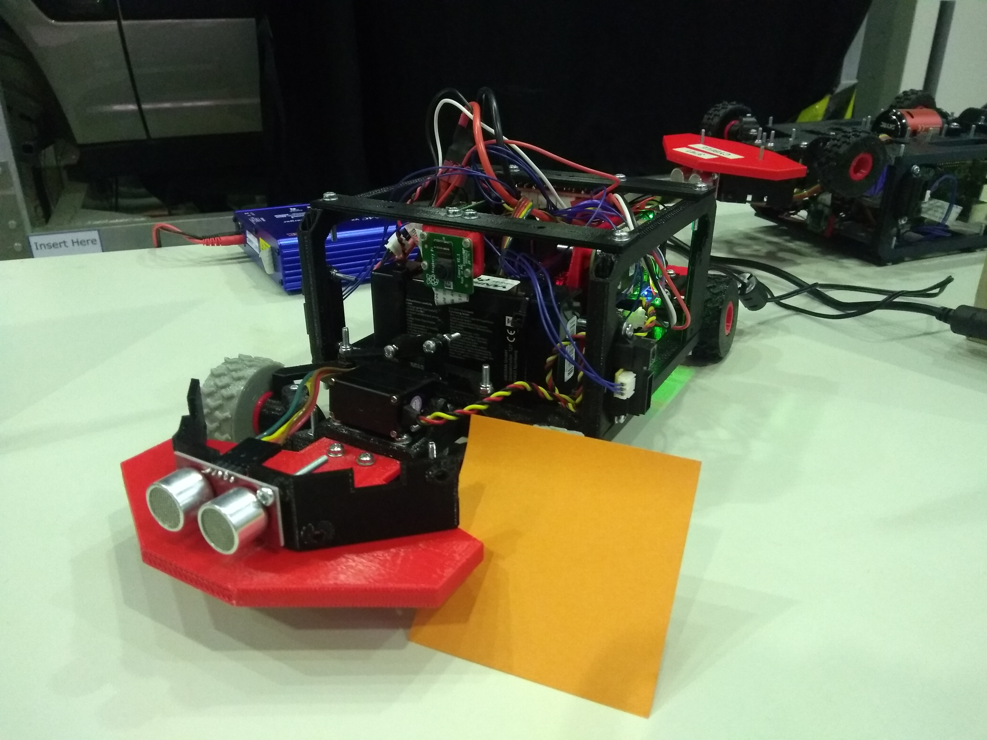
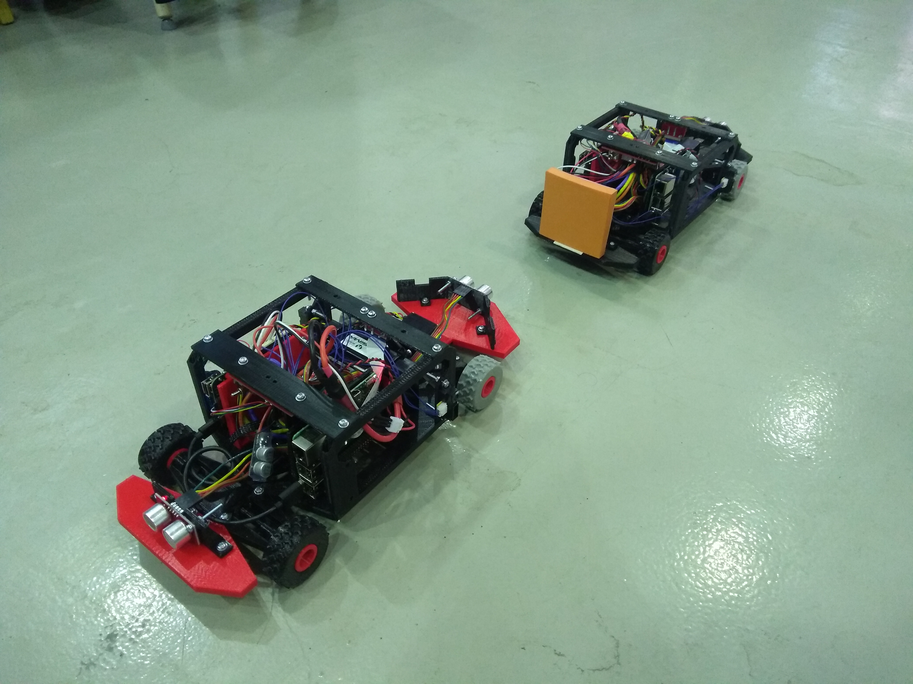
The sticker following Kiwi
Lissy pellaco & Emil brissman
@ WASP summer school 2018

Slide 2
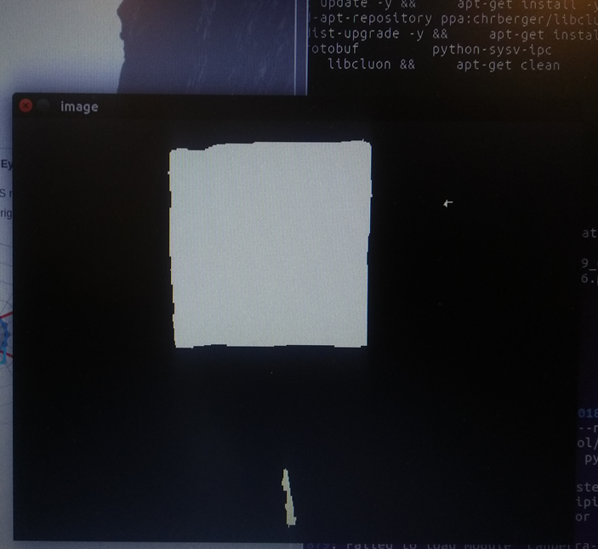
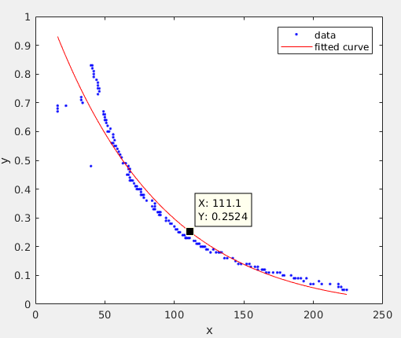
Image Processing
Target: orange sticker
Color Detection: from RGB space to Color name space + threshold
Morphological processing: closure
Detection of the largest connected component (which is hopefully the sticker!)
Centroid and height of the image of the sticker
Centroid is used to compute the steering angle
Height is mapped to the distance from the target

Slide 3
Control
STEERING
P controller
error= center of the image – centroid of the sticker (in the horizontal direction)
Sensor used: camera
ACCELERATION
PD controller
Error= desired distance from the sticker – current distance from the sticker
Sensor used: camera and ultrasound

Slide 4
Practical Issues
Controller tuning (especially PD controller for acceleration)
Smart logic
Sensor Fusion
Robust detection to different light conditions
Smooth control signal
…

